Slide 1
Week 2 Part 1 Assignment
Gabrielle Bartomeo, Zach Dravis, Peter Lombardo, and Hovig Ohannessian

Slide 2
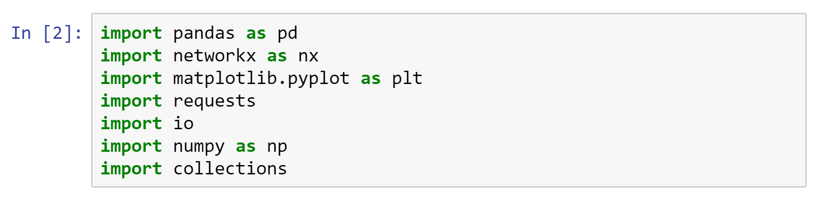
Data setup
Notes:
First we imported the libraries we would need
Pandas is crucial—it allowed us to treat our data as a database, rather than a dictionary or a comma separated list
We used networkx and matplot’s pyplot for graphing. Also numpy
Requests and io were used to retrieve the data from the web.
And finally, collections was used to calculate degree distribution

Slide 3
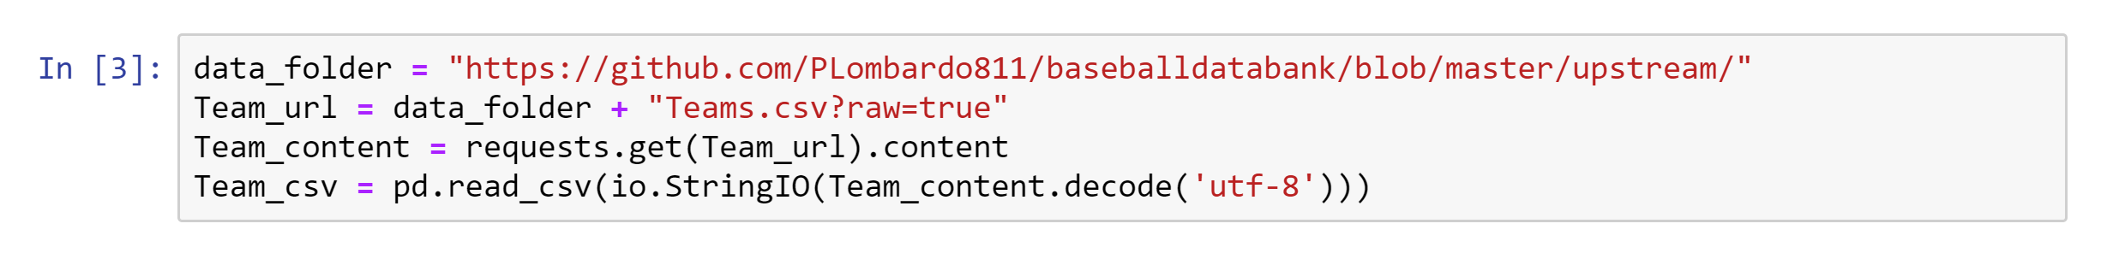
Import Data
Notes:
We loaded the data set and used the requests library to pull the data followed by pandas to turn it into a csv. io was used to make everything into a string.

Slide 4
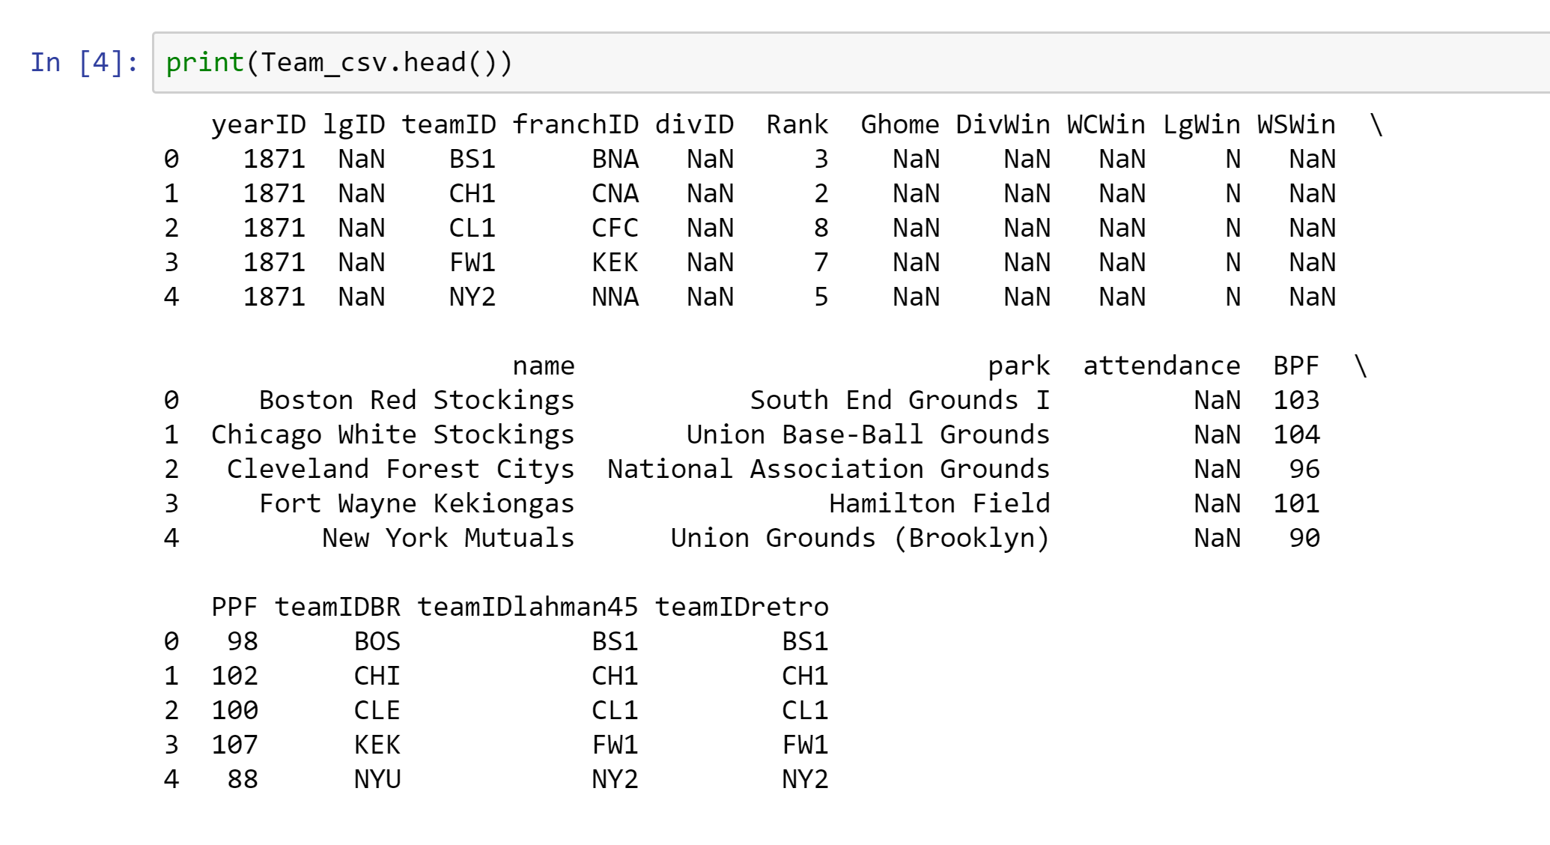
Data cleaning
Notes:
We made minimal changes to the data.
The changes we made included coercing a variable to string type and removing null data.

Slide 5
Making the graph
Notes:
We copied the dataset to include only the yearID column and the franchID column
Franchise ID is a column unique to any franchise name in MLB. These two columns together show which year any given franchise was in existence with that name.
We then create a new column storing the ages as tuples with the format being yearID first and franchID second.

Slide 6
Making the graph
Notes:
We then create an empty directional graph and added the edges from the tuples we just created in list format and the yearID and franchID in list format to make the nodes.

Slide 7
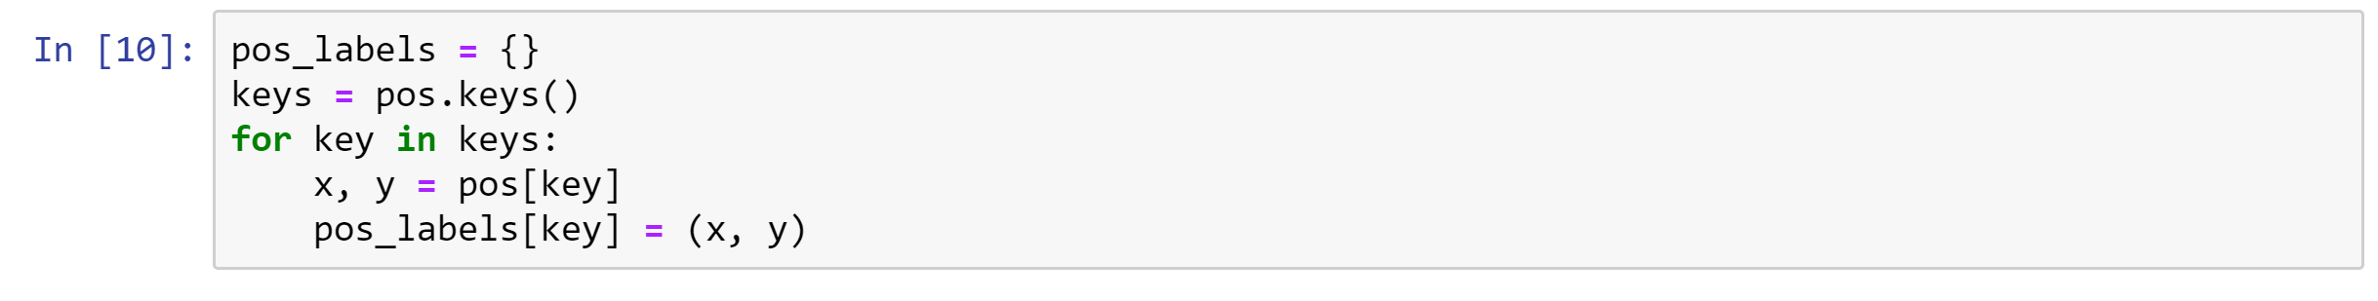
Making the graph
Notes:
We applied the spring layout to position the nodes
We then created labels for each node

Slide 8
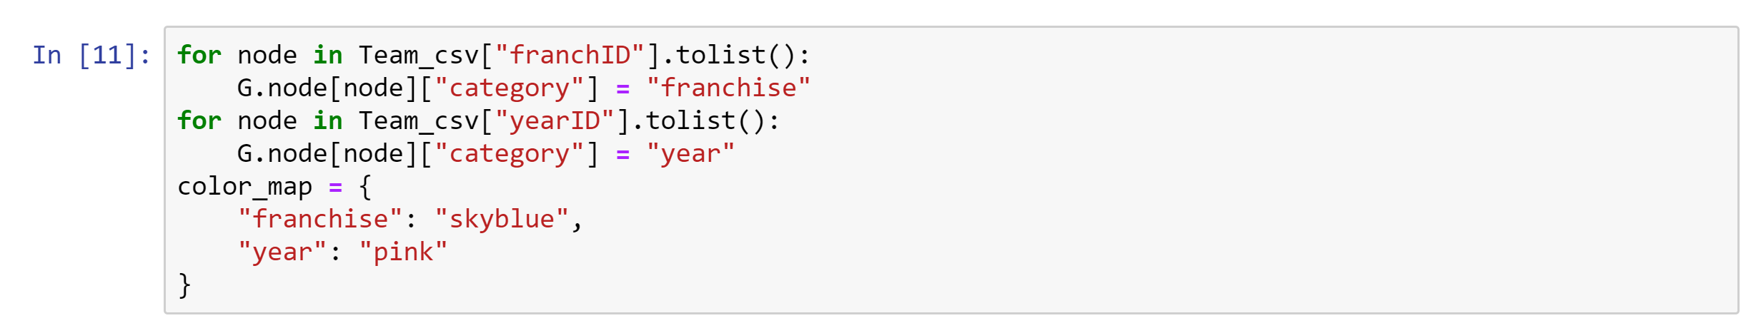
Making the graph
Notes:
We assigned each node a category from its column name in order to color the nodes of the graph according to if they were a franchise or a year

Slide 9
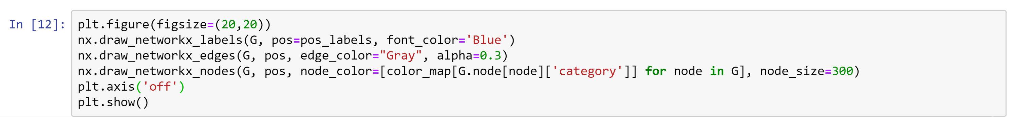
Formatting the graph
Notes:
We made some formatting changes to make the graph semi-transparent and give it some coloring resulting in…

Slide 10
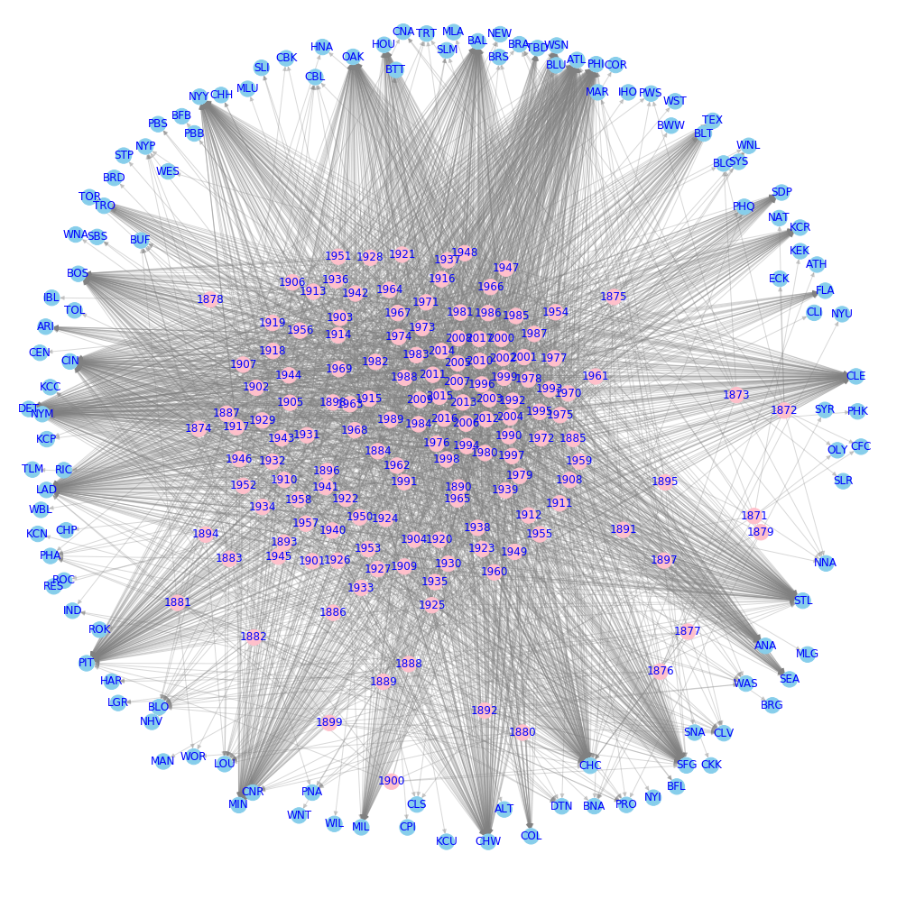

Slide 11
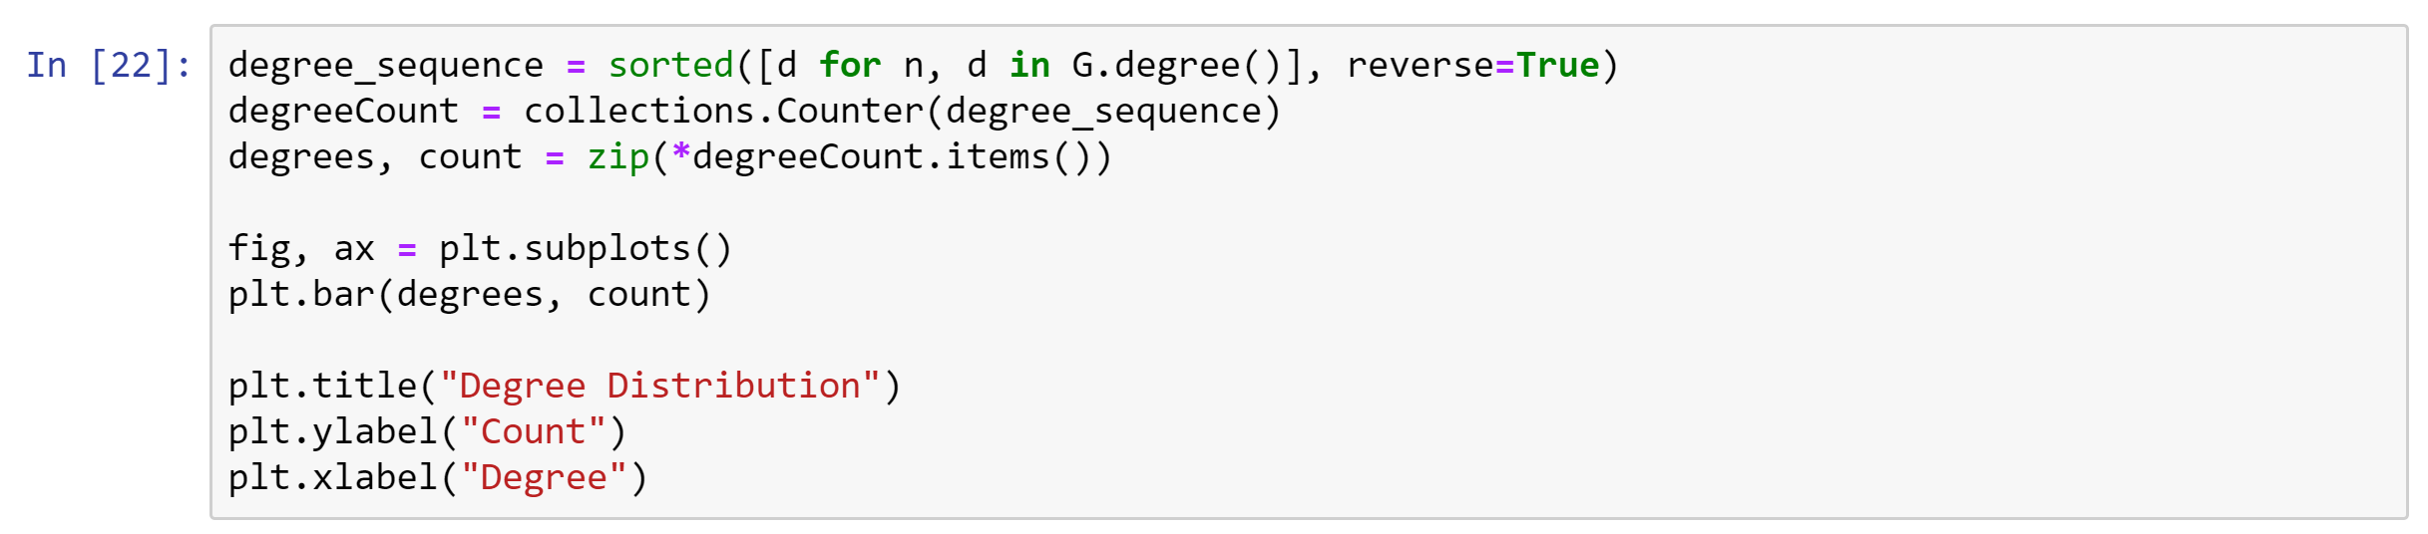
Basic Analyses

Slide 12
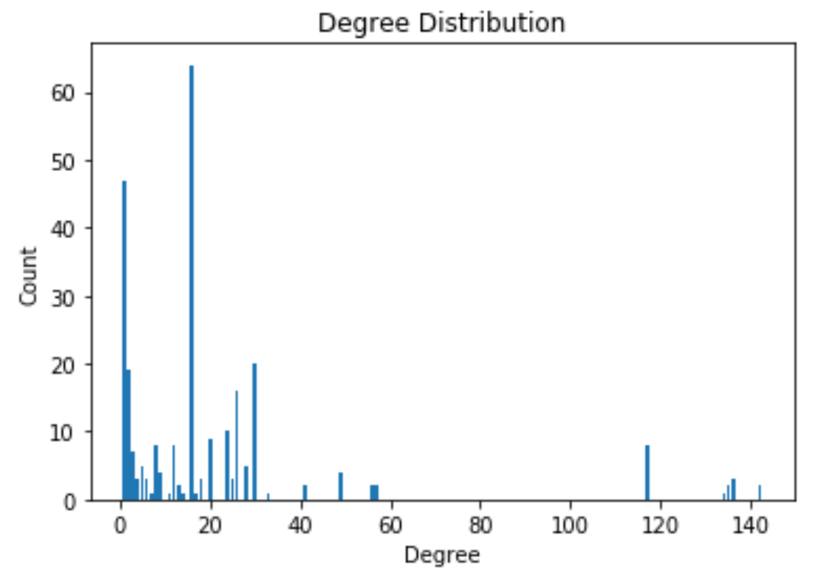
Basic Analyses

